Slide 1
Architectural Design
To explain the advantages and disadvantages of different distributed systems architectures
To discuss client-server and distributed object architectures
To describe object request brokers and the principles underlying the CORBA standards
To introduce peer-to-peer and service-oriented architectures as new models of distributed computing.
1

Slide 2
Topics covered
Architectural design decisions
System organization
Decomposition styles
Control styles
Reference architectures

Slide 3
Software architecture
The design process for identifying the sub-systems making up a system and the framework for sub-system control and communication is architectural design.
The output of this design process is a description of the software architecture.

Slide 4
Architectural design
An early stage of the system design process.
Represents the link between specification and design processes.
Often carried out in parallel with some specification activities.
It involves identifying major system components and their communications.

Slide 5
Advantages of explicit architecture
Stakeholder communication
  Architecture may be used as a focus of discussion by system stakeholders.
System analysis
  Means that analysis of whether the system can meet its non-functional requirements is possible.
Large-scale reuse
  The architecture may be reusable across a range of systems.

Slide 6
Architecture and system characteristics
Performance
  Localize critical operations and minimize communications. Use large rather than fine-grain components.
Security
  Use a layered architecture with critical assets in the inner layers.
Safety
  Localize safety-critical features in a small number of sub-systems.
Availability
  Include redundant components and mechanisms for fault tolerance.
Maintainability
  Use fine-grain, replaceable components.

Slide 7
Architectural conflicts
Using large-grain components improves performance but reduces maintainability.
Introducing redundant data improves availability but makes security more difficult.
Localising safety-related features usually means more communication so degraded performance.

Slide 8
Architectural design decisions
Is there a generic application architecture that can be used?
How will the system be distributed?
What architectural styles are appropriate?
What approach will be used to structure the system?
How will the system be decomposed into modules?
What control strategy should be used?
How will the architectural design be evaluated?
How should the architecture be documented?

Slide 9
System organization
Reflects the basic strategy that is used to structure a system.
Three organisational styles are widely used:
  A shared data repository style;
  A shared services and servers style;
  An abstract machine or layered style.

Slide 10
The repository model
Sub-systems must exchange data. This may be done in two ways:
  Shared data is held in a central database or repository and may be accessed by all sub-systems;
  Each sub-system maintains its own database and passes data explicitly to other sub-systems.
When large amounts of data are to be shared, the repository model of sharing is most commonly used.

Slide 11
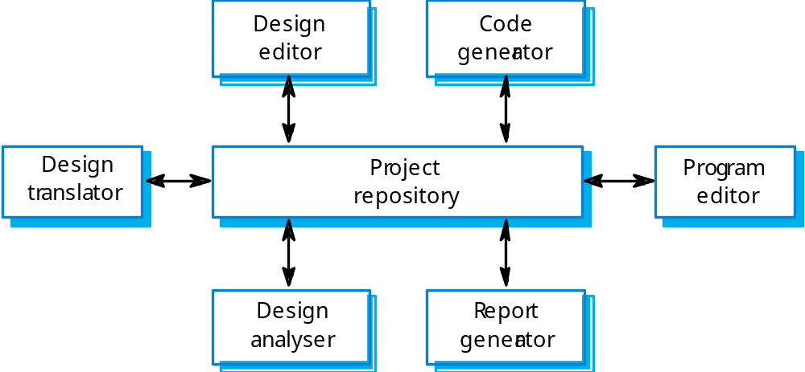
CASE toolset architecture

Slide 12
Repository model characteristics
Advantages
  Efficient way to share large amounts of data;
  Sub-systems need not be concerned with how data is produced Centralised management e.g. backup, security, etc.
  Sharing model is published as the repository schema.
Disadvantages
  Sub-systems must agree on a repository data model. Inevitably a compromise;
  Data evolution is difficult and expensive;
  No scope for specific management policies;
  Difficult to distribute efficiently.

Slide 13
Client-server model
Distributed system model which shows how data and processing is distributed across a range of components.
Set of stand-alone servers which provide specific services such as printing, data management, etc.
Set of clients which call on these services.
Network which allows clients to access servers.

Slide 14
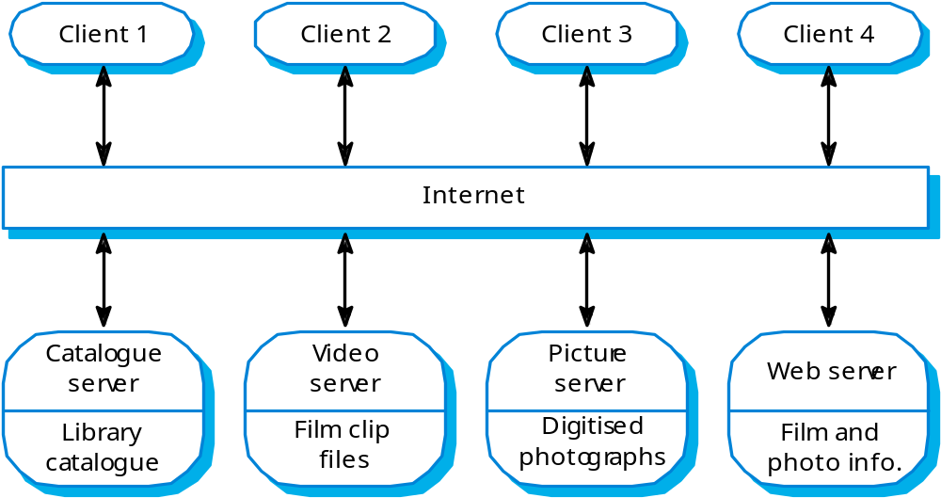
Film and picture library

Slide 15
Client-server characteristics
Advantages
  Distribution of data is straightforward;
  Makes effective use of networked systems. May require cheaper hardware;
  Easy to add new servers or upgrade existing servers.
Disadvantages
  No shared data model so sub-systems use different data organisation. Data interchange may be inefficient;
  Redundant management in each server;
  No central register of names and services - it may be hard to find out what servers and services are available.

Slide 16
Sub-systems and modules
A sub-system is a system in its own right whose operation is independent of the services provided by other sub-systems.
A module is a system component that provides services to other components but would not normally be considered as a separate system.

Slide 17
Modular decomposition
Another structural level where sub-systems are decomposed into modules.
Two modular decomposition models covered
  An object model where the system is decomposed into interacting object;
  A pipeline or data-flow model where the system is decomposed into functional modules which transform inputs to outputs.

Slide 18
Object models
Structure the system into a set of loosely coupled objects with well-defined interfaces.
Object-oriented decomposition is concerned with identifying object classes, their attributes and operations.
When implemented, objects are created from these classes and some control model used to coordinate object operations.

Slide 19
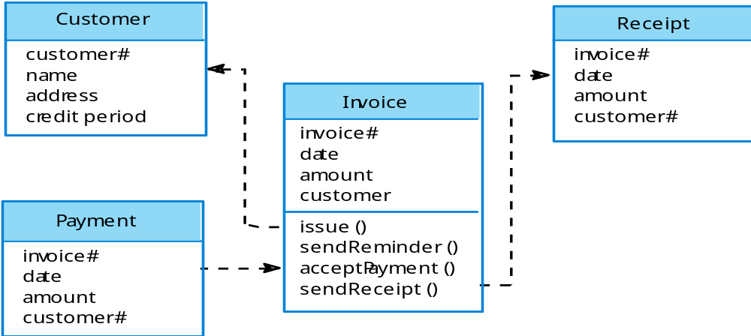
Invoice processing system

Slide 20
Object model advantages
Objects are loosely coupled so their implementation can be modified without affecting other objects.
The objects may reflect real-world entities.
OO implementation languages are widely used.
However, object interface changes may cause problems and complex entities may be hard to represent as objects.

Slide 21
Function-oriented pipelining
Functional transformations process their inputs to produce outputs.
May be referred to as a pipe and filter model (as in UNIX shell).
Variants of this approach are very common. When transformations are sequential, this is a batch sequential model which is extensively used in data processing systems.
Not really suitable for interactive systems.

Slide 22
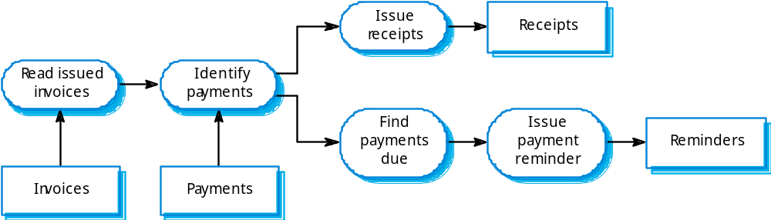
Invoice processing system

Slide 23
Pipeline model advantages
Supports transformation reuse.
Intuitive organisation for stakeholder communication.
Easy to add new transformations.
Relatively simple to implement as either a concurrent or sequential system.
However, requires a common format for data transfer along the pipeline and difficult to support event-based interaction.

Slide 24
Control styles
Are concerned with the control flow between sub-systems. Distinct from the system decomposition model.
Centralised control
  One sub-system has overall responsibility for control and starts and stops other sub-systems.
Event-based control
  Each sub-system can respond to externally generated events from other sub-systems or the system’s environment.

Slide 25
Centralized control
A control sub-system takes responsibility for managing the execution of other sub-systems.
Call-return model
  Top-down subroutine model where control starts at the top of a subroutine hierarchy and moves downwards. Applicable to sequential systems.
Manager model
  Applicable to concurrent systems. One system component controls the stopping, starting and coordination of other system processes. Can be implemented in sequential systems as a case statement.

Slide 26
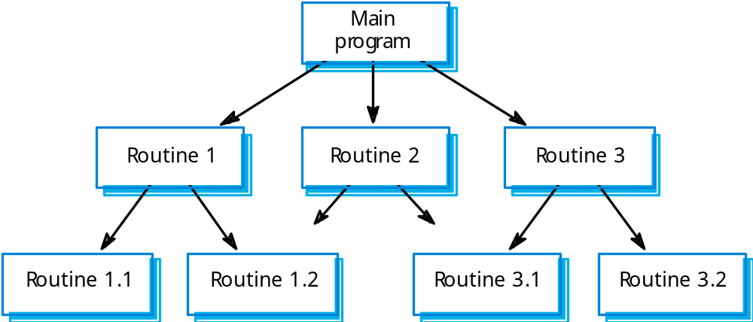
Call-return model

Slide 27
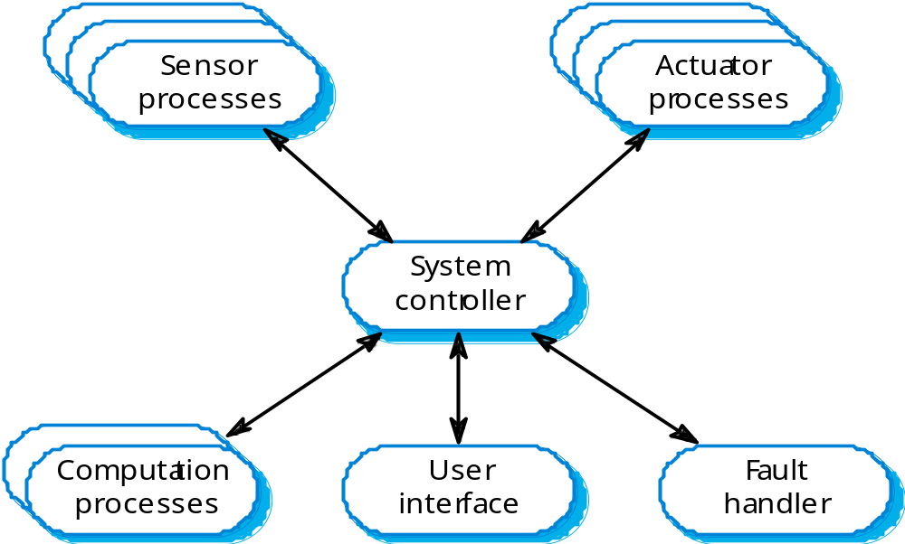
Real-time system control

Slide 28
Event-driven systems
Driven by externally generated events where the timing of the event is outwith the control of the sub-systems which process the event.
Two principal event-driven models
  Broadcast models. An event is broadcast to all sub-systems. Any sub-system which can handle the event may do so;
  Interrupt-driven models. Used in real-time systems where interrupts are detected by an interrupt handler and passed to some other component for processing.
Other event driven models include spreadsheets and production systems.

Slide 29
Broadcast model
Effective in integrating sub-systems on different computers in a network.
Sub-systems register an interest in specific events. When these occur, control is transferred to the sub-system which can handle the event.
Control policy is not embedded in the event and message handler. Sub-systems decide on events of interest to them.
However, sub-systems don’t know if or when an event will be handled.

Slide 30
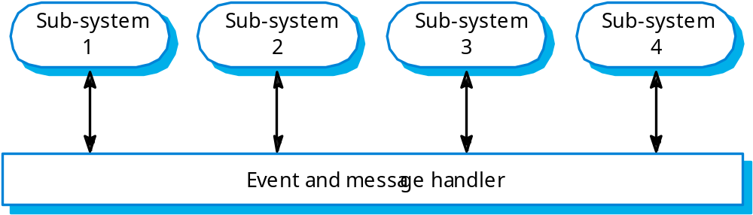
Selective broadcasting

Slide 31
Interrupt-driven systems
Used in real-time systems where fast response to an event is essential.
There are known interrupt types with a handler defined for each type.
Each type is associated with a memory location and a hardware switch causes transfer to its handler.
Allows fast response but complex to program and difficult to validate.

Slide 32
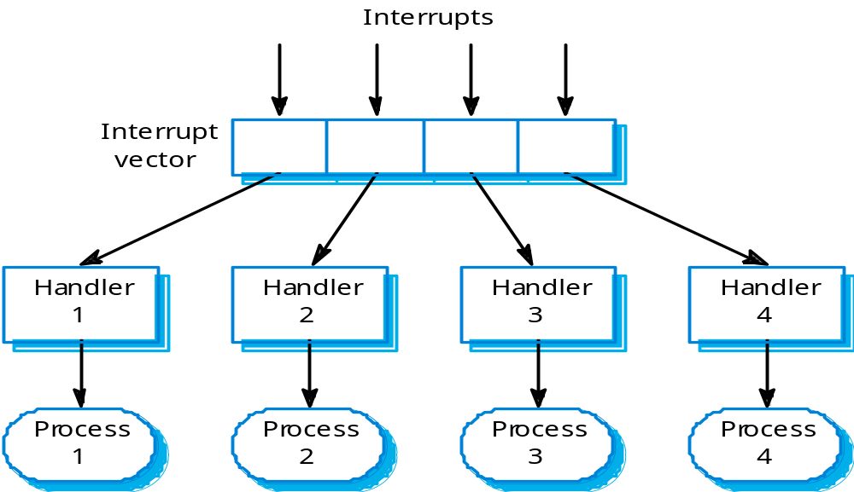
Interrupt-driven control

Slide 33
Reference architectures
Architectural models may be specific to some application domain.
Two types of domain-specific model
  Generic models which are abstractions from a number of real systems and which encapsulate the principal characteristics of these systems. Covered in Chapter 13.
  Reference models which are more abstract, idealised model. Provide a means of information about that class of system and of comparing different architectures.
Generic models are usually bottom-up models; Reference models are top-down models.

Slide 34
Reference architectures
Reference models are derived from a study of the application domain rather than from existing systems.
May be used as a basis for system implementation or to compare different systems. It acts as a standard against which systems can be evaluated.
OSI model is a layered model for communication systems.

Slide 35
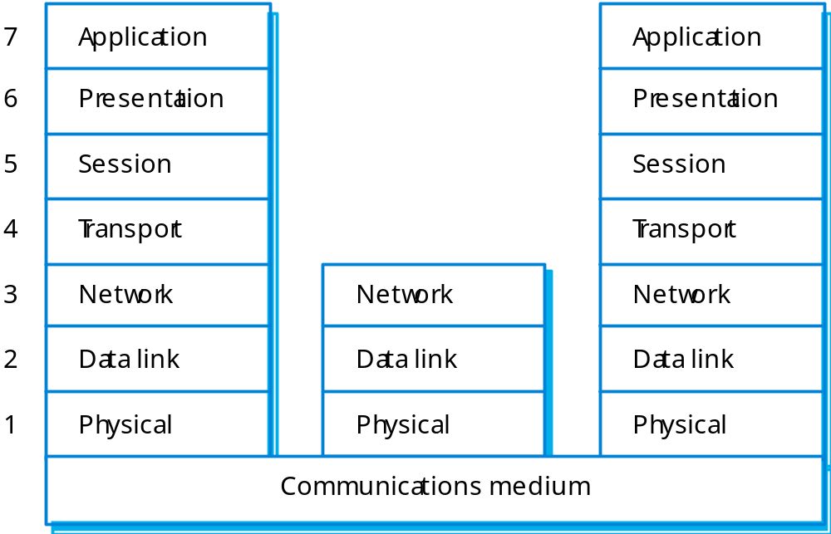
OSI reference model

Slide 36
Case reference model
Data repository services
  Storage and management of data items.
Data integration services
  Managing groups of entities.
Task management services
  Definition and enaction of process models.
Messaging services
  Tool-tool and tool-environment communication.
User interface services
  User interface development.

